Slide 1
Mechanics of Materials.
Mechanics of materials is a branch of applied mechanics that deals with the behavior of solid bodies subjected to various types of loading.
Other names for this field of study are strength of materials and mechanics of deformable bodies.
The solid bodies considered are bars with axial loads, shafts in torsion, beams in bending, and columns in compression.
An understanding of mechanical behavior is essential for the safe design of all types of structures, such as airplanes, buildings and bridges, machines and motors, or ships and spacecraft. That is why mechanics of materials is a basic subject in so many engineering fields.

Slide 2
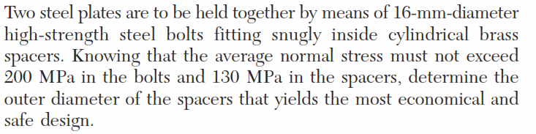
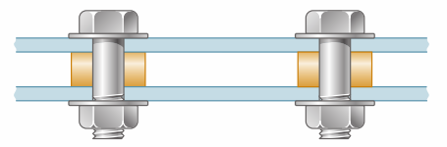
Problem statement

Slide 3
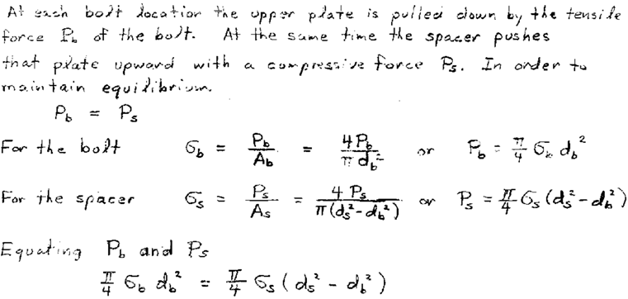

Slide 4
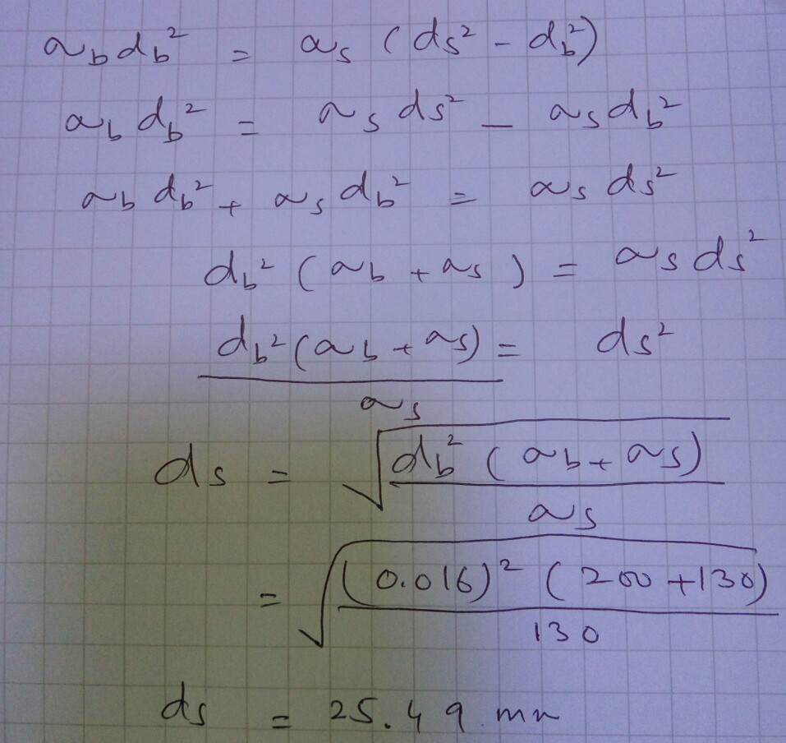

Slide 5
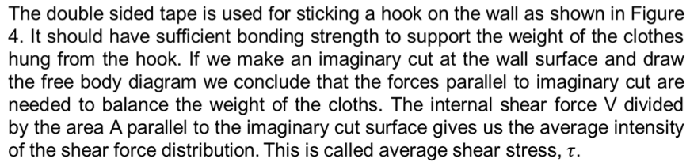
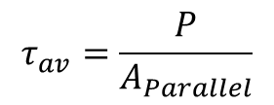
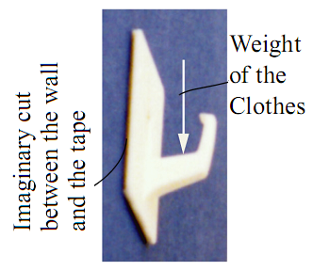
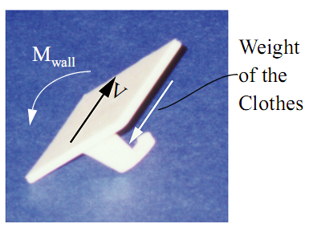
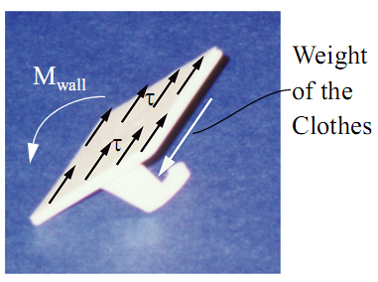
Shearing stress
Figure 4

Slide 6
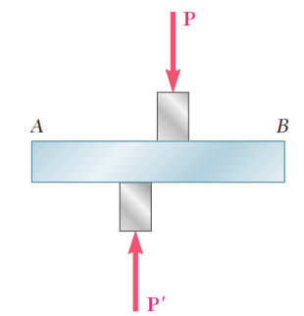
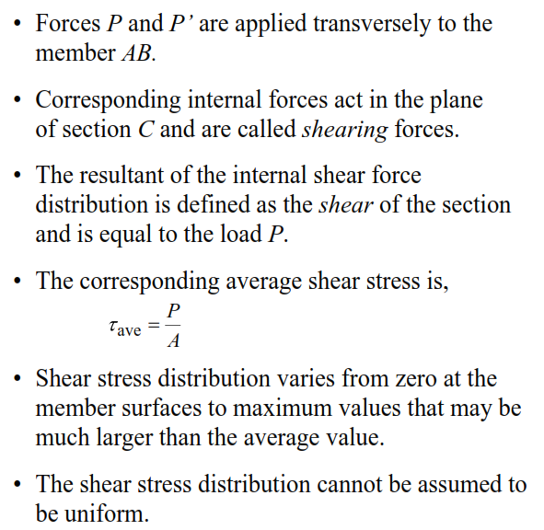
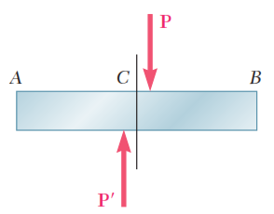
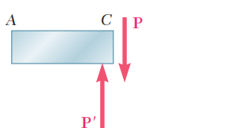
Shearing stress

Slide 7
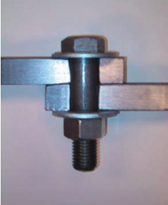
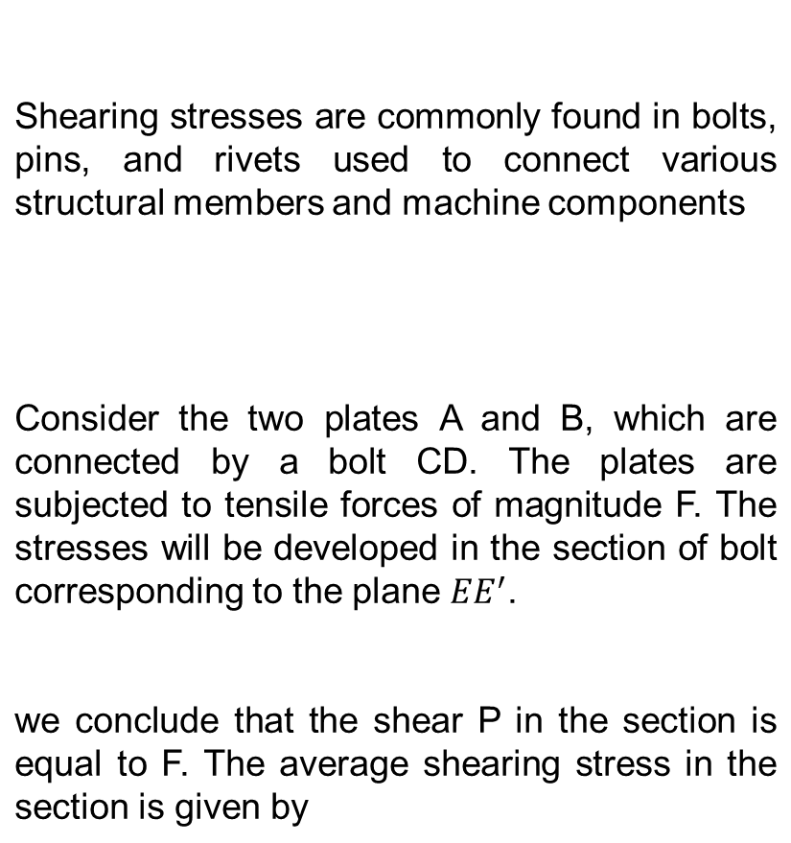
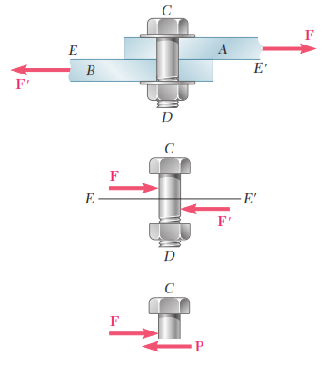

Shearing stress in Connection

Slide 8
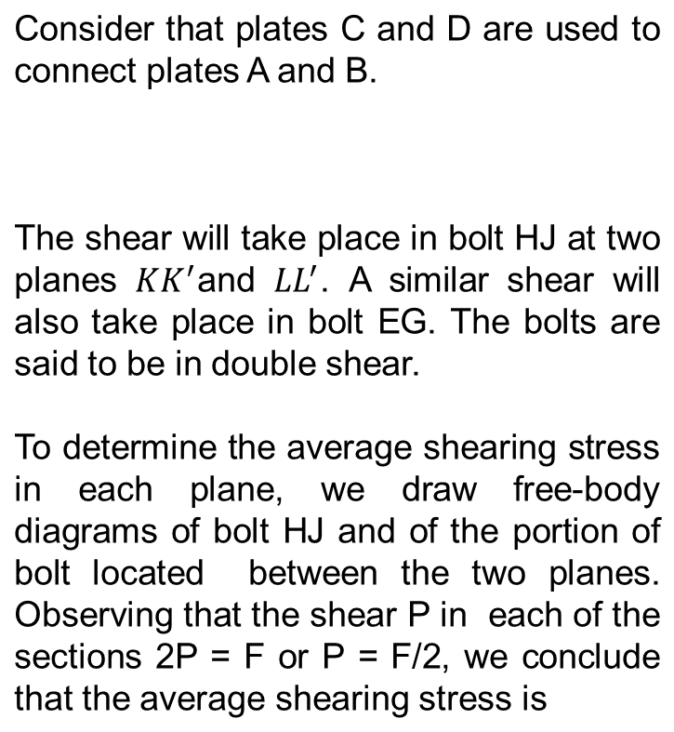
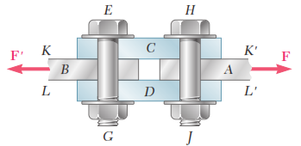
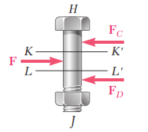


Bolts subjected to double Shear

Slide 9
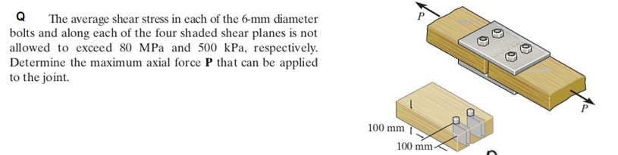

Slide 10
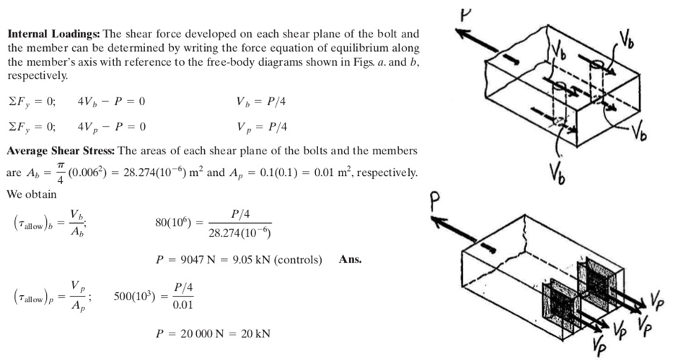

Slide 11
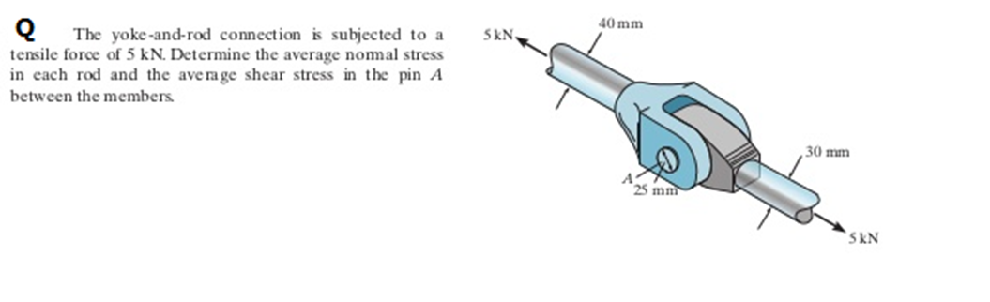

Slide 12
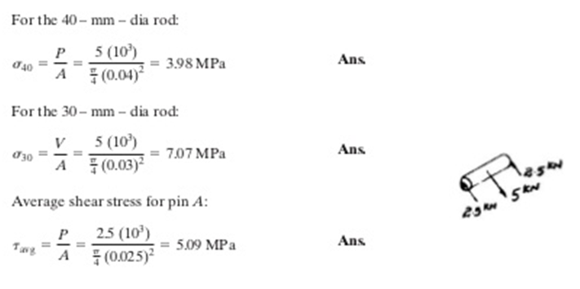

Slide 13
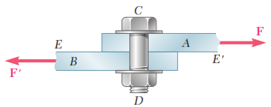
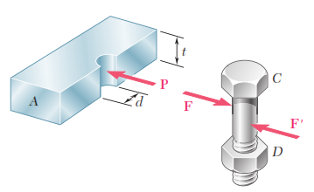
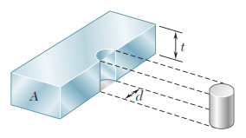

Bearing Stress in Connections
Bolts, pins, and rivets create stresses in the members they connect, along the bearing surface, or surface of contact.
Consider again the two plates A and B connected by a bolt CD. The bolt exerts a force P on plate A which is equal and opposite to the force F exerted by the plate on the bolt.
The bearing stress, obtained by dividing the load P by the area of the rectangle representing the projection of the bolt on the plate section Since this area is equal to td, where t is the plate thickness and d the diameter of the bolt, we have

Slide 14

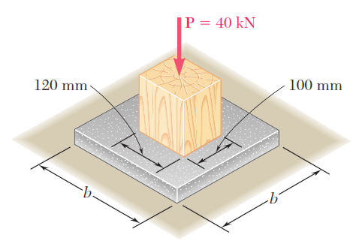
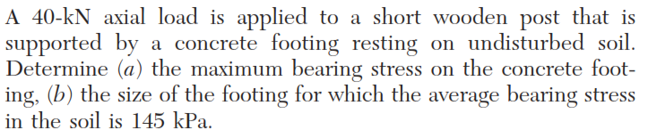
Problem Statement

Slide 15
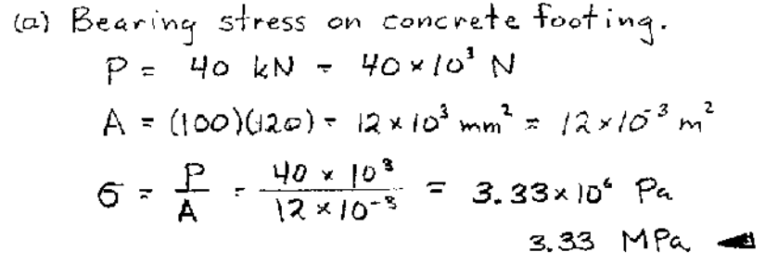

Slide 16
